Slide 1
Version 2.18
UCSD CSE 30
Computer Organization and Systems Programming
Lecture - 10
Keith Muller
Vax 11/780 1980

Slide 2

Thursday office hours moved to
Section B ZOOM Midterm Review
Thursday 7:30 PM – 8:30 PM
(My office hours zoom #)
(see canvas for number)

Slide 3
Accessing members of a struct
High address
You can create an array of structs and initialize them
struct date { // defining struct type
int month; // member month
int day; // member date
};
day
10
quarter[4]
month
9
day
8
quarter[3]
month
7
day
6
quarter[2]
month
5
struct date quarter[] =
{ {1,2}, {3,4}, {5,6}, {7,8}, {9,10} };
int cnt = sizeof(quarter)/sizeof(*quarter); // = 5
quarter[0].month = 1;
quarter[0].day = 2;
day
4
quarter[1]
month
3
day
2
quarter[0]
month
1
Low address
x

Slide 4
Accessing members of a struct
day
5
quarter[2]
month
3
ptr
day
21
quarter[1]
month
2
struct date quarter[3];
struct date *ptr;
ptr = quarter + 1; // array name = address
ptr->month = 2;
ptr->day = 21; // or (*ptr).day = 21;
(ptr-1)->month = 1; // or (*(ptr-1)).month = 4;
(ptr-1)->day = 7;
(++ptr)->month = 3;
ptr->day = 5;
day
7
quarter[0]
month
1
x

Slide 5
Typedef usage with Struct – Another Style Conflict
Typedef is a way to create an alias for another data type (not limited to just structs) typedef <data type> <alias>;
After typedef, the alias can be used interchangeably with the original data type
e.g., typedef unsigned long int size_t;
Some claim typedefs are easier to understand than tagged struct variables, others not
typedef with structs are not allowed in the cse30 style guidelines (Linux kernel standards)
struct nm {
/* fields */
};
typedef struct nm item;
item n1;
struct nm n2;
item *ptr;
struct nm *ptr2;
typedef struct name2_s {
int a;
int b;
} name2_s;
name2_s var2;
name2_s *ptr2;
typedef struct {
int a;
int b;
} pair;
pair var3;
pair *ptr3;
x

Slide 6
Assigning Structs in an expression
You can assign (copy) each member value of a struct from a struct of the same type Performance Caution: this copies the contents of each struct member during execution
Individual members can also be copied
struct date first = {1, 1};
struct date final = {.day= 31, .month= 12};
struct date *pt1 = &first;
struct date *pt2 = &final;
final.day = first.day; // both day are 1
final = first; // copies whole struct
pt2->month = 3;
*pt1 = *pt2; // copies whole struct
pt2->day = 7;
pt1->day = pt2->day; // both days are now 7
first
day
7
1
ptr1
month
3
1
low address
final
day
7
31
1
ptr2
month
1
12
3
low address
x

Slide 7
Caution: Assignment is a Shallow Copy of struct members
struct vehicle car1 = {"CA", "UCSD CSE"};
struct vehicle car2;
struct vehicle {
char *state;
char *plate;
};
plate
"UCSD CSE"
immutable strings
(read only data)
state
"CA"
car1
When you assign one struct to another, it copies member contents including pointer values!
car2 = car1; // copies members exactly
"UCSD ECE"
"UCSD CSE"
plate
plate
car2
car1
car2.plate = "UCSD ECE";
state
state
Warning
Be very careful with "shallow copies" in C
when pointers are involved
"CA"
x

Slide 8
Struct: Copy and Member Pointers --- "Deep Copy"
struct vehicle {
char *state;
char *plate;
};
struct vehicle car1 = {"CA", "UCSD CSE"};
struct vehicle car2;
mutable strings (heap memory)
Use strdup() to copy the strings
immutable strings (read-only data)
"UCSD CSE"
"UCSD CSE"
"UCSD ECE"
car2.plate = strdup(car1.plate);
car2.state = strdup(car1.state);
……
car1.plate = "UCSD ECE";
plate
plate
car2
car1
state
state
"CA"
"CA"
x

Slide 9
Deep Copies of Structs
Must first allocate space to be pointed at by member pointers independently (they are not part of the struct, only the pointers are) then copy what they point at
struct vehicle {
char *state;
char *plate;
int year;
};
struct vehicle car1 = {"CA", "CSE", 2021};
struct vehicle *pn = malloc(sizeof(*pn));
// check if malloc() failed not shown
Dynamic allocation (on heap)
year
2021
pn
plate
"CSE"
state
"CA"
low address
violet areas show memory contents
pn->state = strdup(car1.state);
pn->plate = strdup(car1.plate);
pn->year = car1.year;
x

Slide 10
Nested Structs
Structs like any other variable can be a member of a struct, this is called a nested struct
struct date {
int month;
int day;
};
struct person {
char *name;
struct date bday;
};
bday
day
24
ptr
month
1
name
"Joe"
low address
struct person first;
struct person *ptr;
ptr = &first;
first.name = "Sam"; // immutable string
first.name = (char []) {"Joe"}; // mutable string, lost address to Sam
first.bday.month = 1;
first.bday.day = 24;
// below is the same as above
ptr->bday.month = 1;
ptr->bday.day = 24;
x

Slide 11
Comparing Two Structs
You cannot compare entire structs, you must compare them one member at a time
struct vehicle {
char *state;
char *plate;
int doors;
};
doors
4
2
doors
plate
"UCSD"
plate
"abc"
state
"CA"
state
"NY"
car1
car2
struct vehicle car1 = {"CA", "UCSD", 4};
struct vehicle car2 = { (char []) {"NY"}, (char []) {"abc"}, 2};
if ((strcmp(car1.state, car2.state) == 0) &&
(strcmp(car1.plate, car2.plate) == 0) &&
(car1.doors == car2.doors)) {
printf("Same\n");
} else {
printf("Different\n");
}
x

Slide 12
Struct Arrays: Dynamic Allocation
#define HOLIDAY 5
struct date *pt1 = malloc(sizeof(*pt1));
struct date *pt2 = malloc(sizeof(*pt2) * HOLIDAY);
day
21
ptr1
2
month
day
(*pt1).month = 2;
(*pt1).day = 21;
pt2->month = 12;
pt2->day = 25;
(pt2+1)->day = 22; //or (*(pt2+1)).month
free(pt1);
pt1 = NULL;
free(pt2);
pt2 = NULL;
ptr2+4
month
day
ptr2+3
month
day
ptr2+2
month
day
22
ptr2+1
month
day
25
ptr2
month
12
low address
x

Slide 13
Formal Parameter structs: contents set with shallow copies!
WARNING: When you pass a struct, you pass a copy of all the struct members
This is a shallow copy (shallow copy – so if you have members that are pointers watch out)
More often code will pass the pointer to a struct to avoid the copy costs
Be careful and not modify what the pointer points to (unless it is an output parameter)
Tradeoffs:
Passing a pointer is faster and takes less space
Member access cost: indirect accesses through pointers to a struct member may be a bit more expensive and might be harder for compiler to optimize
For small structs like a struct date passing a copy is fine
For large structs always use pointers (arrays of struct, pass a pointer)
For me, I always pass pointers to structs as parameters regardless of size
x

Slide 14
Struct Function Parameters – Be Careful it is not like arrays
void change1(struct vehicle car)
{
car.date = 2022; // oops!
*(car.state) = "P";
}
…
change1(name);
date
2021
plate
"UCSD"
name
state
"PA"
"CA"
date
2022
4
plate
car
Changes the parameter copy
state
void change2(struct vehicle *car)
{
car->date = 2022;
*(car->state) = "P";
}
…
change2(name);
date
4
2022
plate
"UCSD"
name
state
"CA"
"PA"
Changes the caller's version
car
x

Slide 15
Struct as an Output Parameter: Deep Copy Example
struct date {
int month;
int day;
};
struct person {
char *name;
struct date bday;
};
24
bday
day
?
month
1
ptr
?
name
"Joe"
low address
int fill(struct person *ptr, char *name, int month, int day)
{
ptr->bday.month = month;
ptr->bday.day = day;
if ((ptr->name = strdup(name)) == NULL)
return -1;
return 0;
}
…-----------------calling function ----------
struct person first;
if (fill(&first, "Joe", 1, 24) == 0)
printf("%s %d %d\n", first.name, first.bday.month, first.bday.day);
…
x

Slide 16
Review: Singly Linked Linked List - 1
head
Payload Z
Payload Y
Payload X
$$∅$$
Is a linear collection of nodes whose order is not specified by their relative location in memory, like an array
Each node consists of a payload and a pointer to the next node in the list
The pointer in the last node in the list is NULL (or 0)
The head pointer points at the first node in the list (the head is not part of the list)
Nodes are easy to insert and delete from any position without having to re-organize the entire data structure
Advantages of a linked list:
Length can easily be changed (expand and contract) at execution time
Length does not need to be known in advance (like at compile time)
List can continue to expand while there is memory available
x

Slide 17
Review: Singly Linked Linked List - 2
head
1933
1955
2020
$$∅$$
Memory for each node is typically allocated dynamically at execution time (i.e., using heap memory – malloc() etc.) when a new node is added to the list
Memory for each node may be freed at execution time, using free() when a node is removed from the list
Unlike arrays, linked list nodes are usually not arranged (located) sequentially in adjacent memory locations
No fast and convenient way to "jump" to any specific node.
Usually the list must be traversed (walked) from the head to locate if a specific payload is stored in any node
Obviously, the cost in traversing a linked list is O(n)
x

Slide 18
Linked List Using Self-Referential Structs
A self-referential struct is a struct that has one or more members that are pointers to a struct variable of the same type
Self-referential member
points to same type – itself
Example:
struct node {
int date;
struct node *next;
};
next
date
struct node2 {
int month;
int day;
struct node2 *next;
};
struct node2 x;
0
next
x.month = 1;
x.day = 31;
x.next = NULL;
31
day
1
month
head
x low memory
struct node2 *head
head = &x;
x

Slide 19
Creating a Node & Inserting it at the Front of the List
// create node; insert at front when passed head
struct node *
creatNode(int year, char *name, struct node *link)
{
struct node *ptr = malloc(sizeof(*ptr));
if (ptr != NULL) {
if ((ptr->name = strdup(name)) == NULL) {
free(ptr);
return NULL;
}
ptr->year = year;
ptr->next = link;
}
return ptr;
}
struct node {
int year;
char *name;
struct node *next;
};
// calling function body
struct node *head = NULL; // insert at front
struct node *ptr;
if ((ptr = creatNode(2020, "Joe", head)) != NULL) {
head = ptr; // error handling not shown
}
if ((ptr = creatNode(1955, "Sam", head)) != NULL) {
head = ptr; // error handling not shown
}
Never use head here!
you can lose your linked list
if creatNode() fails!
NULL
NULL
head
$$NULL$$
head
2020
"Joe"
head
"Joe"
1955
"Sam"
2020
x

Slide 20
Creating a Node & Inserting it at the End of the List
// create a node and insert at the end of the list
struct node *
insertEnd(int year, char *name, struct node *head)
{
struct node *ptr = head;
struct node *prev = NULL; // base case
struct node *new;
if ((new = creatNode(year, name, NULL)) == NULL)
return NULL;
while (ptr != NULL) {
prev = ptr;
ptr = ptr->next;
}
if (prev == NULL)
return new;
prev->next = new;
return head;
}
head
$$NULL$$
NULL
head
2020
"Joe"
NULL
1955
"Sam"
head
2020
"Joe"
struct node *head = NULL; // insert at end
struct node *ptr;
if ((ptr = insertEnd(2020, "Joe", head)) != NULL)
head = ptr;
if ((ptr = insertEnd(1955, "Sam", head)) != NULL)
head = ptr;
x

Slide 21
"Dumping" the Linked List "walk the list from head to tail"
NULL
struct node {
int year;
char *name;
struct node *next;
};
head
"Joe"
1955
"Sam"
2020
$$∅$$
ptr
ptr
ptr
struct node *head;
struct node *ptr;
…
printf("\nDumping All Data\n");
ptr = head;
while (ptr != NULL) {
printf("year: %d name: %s\n", ptr->year, ptr->name);
ptr = ptr->next;
}
Dumping All Data
year: 1955 name: Sam
year: 2020 name: Joe
x

Slide 22
Finding A Node Containing a Specific Payload Value
NULL
struct node {
int year;
char *name;
struct node *next;
};
head
"Joe"
1955
"Sam"
2020
ptr
ptr
struct node *findNode(char *name, struct node *ptr)
{
while (ptr != NULL) {
if (strcmp(name, ptr->name) == 0)
break;
ptr = ptr->next;
}
return ptr;
}
Returns pointer if found
NULL otherwise
struct node *found;
if ((found = findNode("Joe", head)) != NULL)
printf("year: %d name: %s\n", found->year, found->name);
x

Slide 23
Deleting a Node in a Linked List
NULL
// returns head pointer; may have changed…
struct node *deleteNode(int name, struct node *head)
{
struct node *ptr = head;
struct node *prev = NULL;
while (ptr != NULL) {
if (strcmp(name, ptr->name) == 0)
break;
prev = ptr;
ptr = ptr->next;
}
if (ptr == NULL) // not found return head
return head;
if (ptr == head) // remove first node new head
head = ptr->next;
else
prev->next = ptr->next; // remove not head
free(ptr->name); // free strdup() space
free(ptr);
return head;
}
head
1955
"Sam"
2020
"Joe"
ptr
ptr
NULL
head
1955
"Sam"
ptr
head
NULL
struct node *head = NULL;
head = deleteNode("Joe", head);
head = deleteNode("Sam", head);
x

Slide 24
Improving On Linked List Performance
Pat
Sam
Joe
…
…
…
…
head
…
…
…
…
…
…
$$∅$$
1933
1955
2020
…
When linked lists get long, the cost of finding an entry continues to increase O(n)
How to improve search time?
Break the single linked list into multiple shorter length linked lists
Shorter lists are faster to search
Requires a function that takes a lookup key and selects just one of the shortened lists
Pat
1933
Sam
1955
Joe
2020
How do you determine on which linked list an entry is stored?
$$∅$$
?
…
…
…
…
$$∅$$
Pat
…
…
…
…
$$∅$$
Pat
1933
same as →
1933
x

Slide 25
Hashing
Hash table is an array of pointers to the head of different linked lists (called hash chains)
Each data item must have a unique key that identifies it (e.g., auto license plate)
h(k) is the hash value of key k to encode the key k into an integer
Use the Hash value to map to one entry in the hash table T[ ] of size TABLESIZE
Index = h(k) % TABLESIZE (mod operator % maps a keys hash value to table index)
Keys that hash to the same array index (collide) are put on a linked list
After hashing a key, you then traverse the selected linked list to find the entry
9
Using a Simple hash
h(k) = k // this is has value
index = k % size // map to a chain
Hash Table T[3] of linked list head pointers
TABLESIZE = 3
3
Nodes with keys to be put into the table
5
*(T+2) →
*(T+1) →
*T →
5
8
$$∅$$
5
7
index = h(5) % 3 = 2 -> T+2
7
1
$$∅$$
8
7
3
9
$$∅$$
1
index = h(7) % 3 = 1 -> T+1
x

Slide 26
Hash Table With Collision Chaining (multiple linked lists)
T+2
T+1
T
5
8
$$∅$$
Make TABLESIZE prime as keys are typically not randomly distributed, and have a pattern
Mostly even, mostly multiples of 10, etc.
In general: mostly multiples of some k
If k is a factor of TABLESIZE, then only (TABLESIZE/k) slots will ever be used!
7
1
$$∅$$
3
9
$$∅$$
Hash Table T[3]
TABLESIZE = 3
Calculate index i = hash(key) % TABLESIZE
Go to array element i, i.e., T+i that contains the head pointer for collision chain
Walk the linked list for element, add element, remove element, etc. from the linked list
New items added to the hash table are typically added at the front or at the end of the collision chain linked list (when multiple keys hash to same index .. they collide)
Hash arrays need an index number to select a chain, so if we have a string, we must first convert to a number
x

Slide 27
Simple 32-bit String Hash Function in C (djb2)
uint32_t hash(char *str)
{
uint32_t hash = 0U;
uint32_t c;
while ((c = (unsigned char)*str++) != '\0’)
hash = c + (hash << 6) + (hash << 16) - hash;
return hash;
}
Signed Data types | Unsigned Data types | Exact Size
int32_t | uint32_t | 32 bits (4 bytes)
c | s | e | 3 | 0 | '\0'
ptr
ptr
ptr
ptr
ptr
ptr
Many different algorithms for string hash function (Dan Berman's djb2 above)
<< is the left bit shift operator (later in course)
Fast to compute, has a reasonable key distribution for short 8-bit ASCII strings into 32-bit unsigned ints
x

Slide 28
Allocating the Hash Table (collision chain head pointers) Good use for calloc()
#define TBSZ 3
int main(void)
{
struct node *ptr;
struct node **tab; // pointer to hashtable
uint32_t index;
if ((tab = calloc(TBSZ, sizeof(*tab))) == NULL) {
fprintf(stderr,"Cannot allocate hash table\n");
return EXIT_FAILURE;
}
// continued on next slide
TABLESIZE = 3
tab[2]
tab[1]
tab[0]
$$∅$$
$$∅$$
$$∅$$
tab
x

Slide 29
Inserting Nodes into the Hash Table (at the end)
#define TBSZ 3
unit32_t index;
index = hash("Pat") % TBSZ;
if ((ptr = insertEnd(1933, "Pat", *(tab + index))) != NULL)
*(tab + index) = ptr;
index = hash("Sam") % TBSZ;
if ((ptr = insertEnd(1955, "Sam", *(tab + index))) != NULL)
*(tab + index) = ptr;
index = hash("Sally") % TBSZ;
if ((ptr = insertEnd(2020, "Sally", *(tab + index))) != NULL)
*(tab + index) = ptr; index = hash("Zoe") % TBSZ;
if ((ptr = insertEnd(2022, "Zoe", *(tab + index))) != NULL)
*(tab + index) = ptr;
struct node {
int year;
char *name;
struct node *next;
};
Sam
1955
Zoe
2022
tab+2
tab+1
tab
$$∅$$
$$∅$$
$$∅$$
Sally
2020
$$∅$$
$$∅$$
$$∅$$
Pat
1933
$$∅$$
Notice
Substitute createNode() for insertEnd() to insert nodes at the front of the collision chain instead of at the end of the collision chain
x

Slide 30
"Dumping" the Hash Table (traversing all Nodes)
Sam
1955
Zoe
2022
Dumping All Data
chain: 0
Year: 1933 Name: Pat
chain: 1
Year: 2020 Name: Sally
chain: 2
Year: 1955 Name: Sam
Year: 2022 Name: Zoe
tab+2
tab+1
tab
$$∅$$
$$∅$$
$$∅$$
Sally
2020
$$∅$$
$$∅$$
$$∅$$
Pat
1933
$$∅$$
ptr
ptr
ptr
ptr
printf("\nDumping All Data\n");
for (index = 0U; index < TBSZ; index++) {
ptr = *(tab + index);
printf("chain: %d\n", index);
while (ptr != NULL) {
printf("Year: %d Name: %s\n", ptr->year, ptr->name);
ptr = ptr->next;
}
}
x

Slide 31
Finding a Node with a Specific Payload Value
ptr
ptr
// same routine as shown in a previous slide
struct node *findNode(char *name, struct node *ptr)
{
while (ptr != NULL) {
if (strcmp(name, ptr->name) == 0)
break;
ptr = ptr->next;
}
return ptr;
}
Sam
1955
Zoe
2022
tab+2
tab+1
tab
$$∅$$
$$∅$$
$$∅$$
Sally
2020
$$∅$$
$$∅$$
$$∅$$
Pat
1933
$$∅$$
index = hash("Zoe") % TBSZ;
if ((ptr = findNode("Zoe", *(tab + index))) != NULL)
printf("Found Year: %d name: %s\n", ptr->year, ptr->name);
else
printf("Not Found Zoe\n");
x

Slide 32
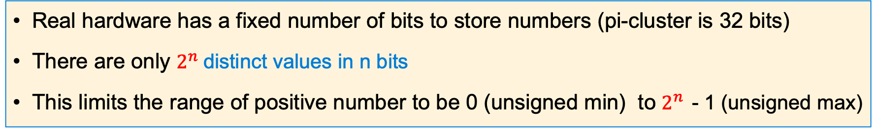
Positive Number (unsigned) in 4 bits
Real hardware has a fixed number of bits to store numbers (pi-cluster is 32 bits)
There are only $2^{n}$distinct values in n bits
This limits the range of positive number to be 0 (unsigned min) to $2^{n }$- 1 (unsigned max)
Hex digit | 0x0 | 0x1 | 0x2 | 0x3 | 0x4 | 0x5 | 0x6 | 0x7
Decimal value | 0 | 1 | 2 | 3 | 4 | 5 | 6 | 7
Binary value | 0b0000 | 0b0001 | 0b0010 | 0b0011 | 0b0100 | 0b0101 | 0b0110 | 0b0111
umin
Hex digit | 0x8 | 0x9 | 0xa | 0xb | 0xc | 0xd | 0xe | 0xf
Decimal value | 8 | 9 | 10 | 11 | 12 | 13 | 14 | 15
Binary value | 0b1000 | 0b1001 | 0b1010 | 0b1011 | 0b1100 | 0b1101 | 0b1110 | 0b1111
umax
x

Slide 33
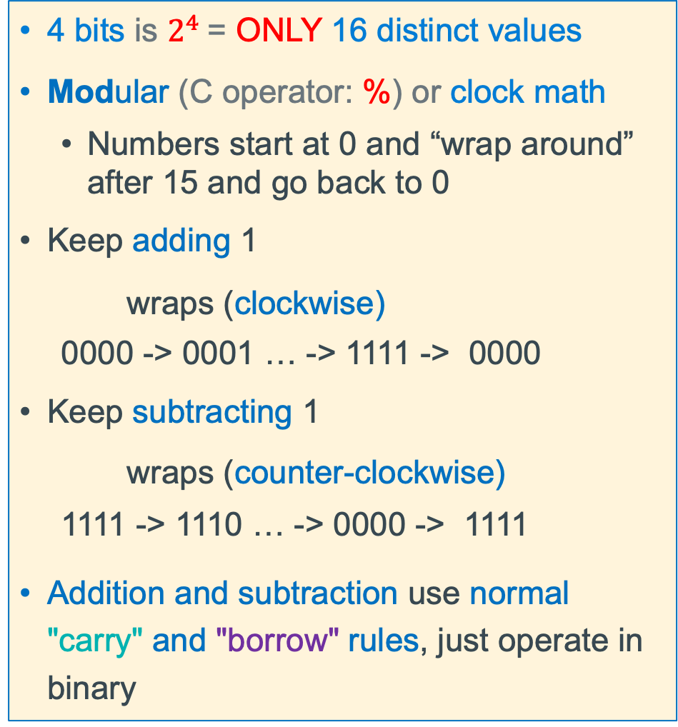
Unsigned Integers (positive numbers) with Fixed # of Bits
4 bits is $2^{4}$= ONLY 16 distinct values
Modular (C operator: %) or clock math
Numbers start at 0 and “wrap around” after 15 and go back to 0
Keep adding 1
wraps (clockwise)
0000 -> 0001 … -> 1111 -> 0000
Keep subtracting 1
wraps (counter-clockwise)
1111 -> 1110 … -> 0000 -> 1111
Addition and subtraction use normal "carry" and "borrow" rules, just operate in binary
x

Slide 34
Unsigned Binary Number: Addition in 4 bits
Be Aware in Binary
1 + 1 = 10 base 10: (1 + 1 = 2)
1 + 1 + 1 = 11 base10: (1 + 1 + 1 = 3)
Carry Bit
carries
0
1
1
1
0 0 0 1
1
+
0 1 1 1
7
sum
1
0
0
0
=
8
x

Slide 35
Unsigned Binary Number: Subtraction in 4 bits
Be Aware in Binary
1 - 1 = 0 base 10: (1 - 1 = 0)
10 - 1 = 1 base10: (2 – 1 = 1)
Borrows
1
0 1 0 1
5
-
-
0 0 1 1
3
sum
0
0
1
0
2
=
x

Slide 36
Unsigned Binary Number: Addition in 4 bits – Overflow!
Be Aware in Binary
1 + 1 = 10 base 10: (1 + 1 = 2)
1 + 1 + 1 = 11 base10: (1 + 1 + 1 = 3)
Carry Bit
carries
1
1
1
1 0 1 0
10
+
0 1 1 1
7
0
0
0
1
17
sum
=
x

Slide 37
Unsigned Binary Number: Subtraction in 4 bits – Overflow!
Be Aware in Binary
1 - 1 = 0 base 10: (1 - 1 = 0)
10 - 1 = 1 base10: (2 – 1 = 1)
Borrows
1
1
1
0
1
0 1 0 1
5
-
0 1 1 1
7
-
sum
1
1
1
0
=
2
x

Slide 38
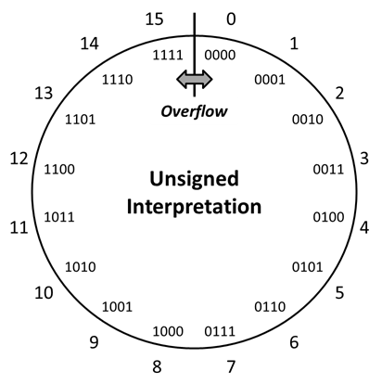
Overflow: Going Past the Boundary Between umax and umin
umax
umin
Overflow with unsigned numbers: Occurs when an arithmetic result (from addition or subtraction for example) is is more than min or max limits
Example shown is for a 4-bit number
C (and Java) ignore overflow exceptions
You end up with a bad value in your program and absolutely no warning or indication… happy debugging!….
x

Slide 39



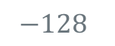
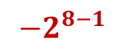
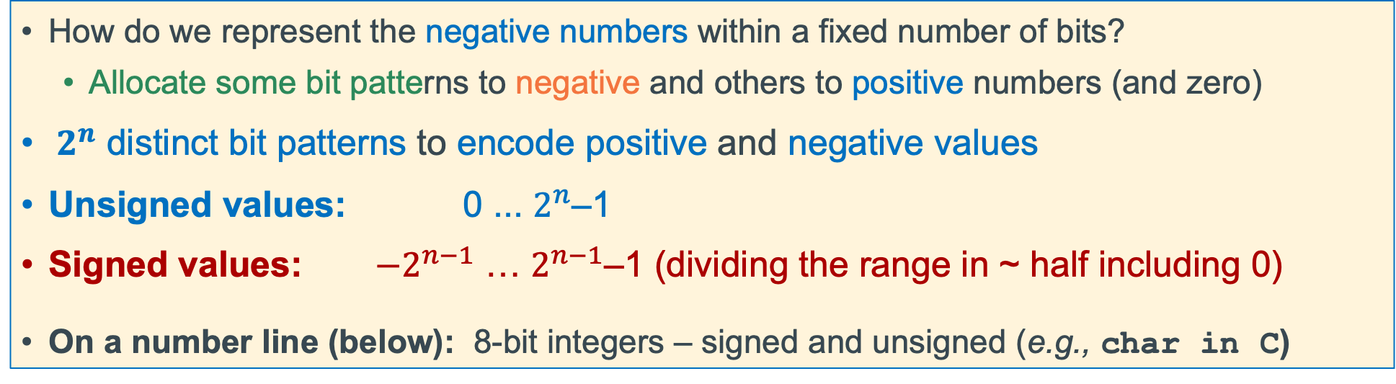
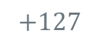
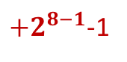
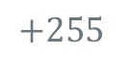


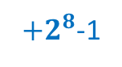
Problem: How to Encode Both Positive and Negative Integers
How do we represent the negative numbers within a fixed number of bits?
Allocate some bit patterns to negative and others to positive numbers (and zero)
$2^{n}$ distinct bit patterns to encode positive and negative values
Unsigned values: 0 ... $2^{n}$–1
Signed values: $−2^{n−1}$ … $2^{n−1}$–1 (dividing the range in ~ half including 0)
On a number line (below): 8-bit integers – signed and unsigned (e.g., char in C)
-1 comes from counting 0 as a "positive" number
$$0$$
Unsigned
$+2^{8}$-1
-$∞$
+$∞$
$$−128$$
$$0$$
$$+127$$
$$+255$$
$${−2}^{8−1}$$
$$0$$
Signed
${+2}^{8−1}$-1
Same “width” (same number of encodings), just shifted in value
x

Slide 40
Negative Integer Numbers: Sign + Magnitude Method
these numbers show bit position boundaries
31
30
0
Sign bit
Remaining bits
MSB
LSB
Use the Most Significant Bit as a sign bit
0 as the MSB represents positive numbers
1 as the MSB represents negative numbers
Two (oops) representations for zero: 0000, 1000
Tricky Math (must handle sign bit independently)
Positive and Negatives “increment” (+1) in the opposite directions!
x

Slide 41
Signed Magnitude Examples (Sign bit is always MSB)
Examples (4 bits):
0 110
0 0000000
1 000 = -0
1 001 = -1
1 010 = -2
1 011 = -3
1 100 = -4
1 101 = -5
1 110 = -6
1 111 = -7
0 000 = 0
0 001 = 1
0 010 = 2
0 011 = 3
0 100 = 4
0 101 = 5
0 110 = 6
0 111 = 7
positive
6
positive
0
1 011
1 0001100
negative
3
negative
12
x

Slide 42
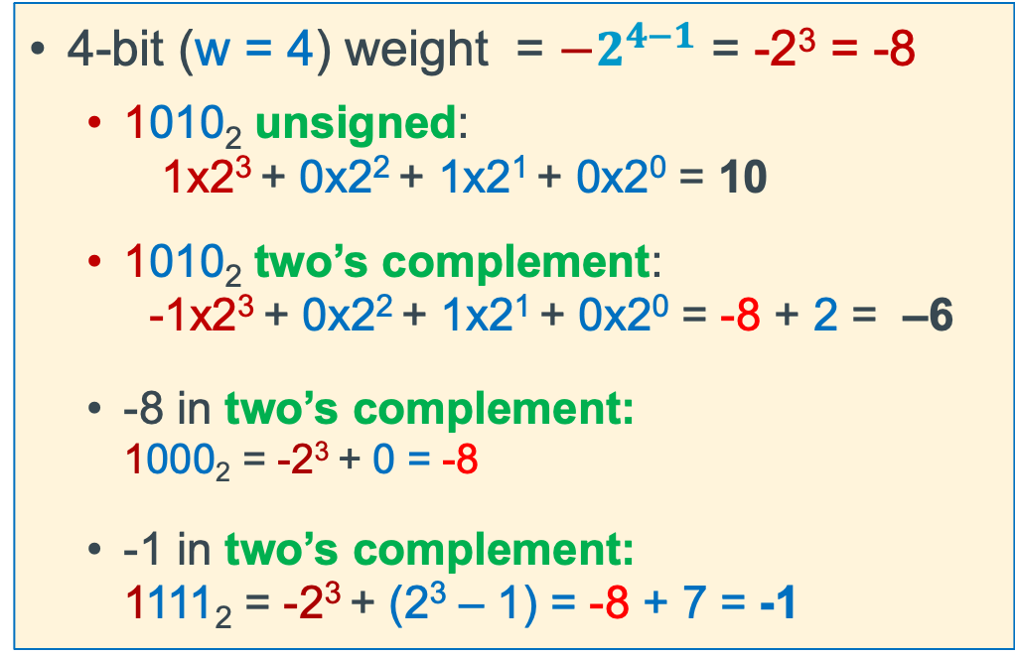
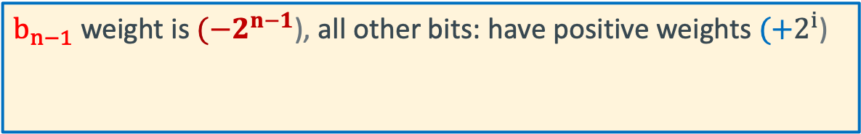
Two’s Complement: The MSB Has a Negative Weight
$$2^{′}s Comp={{−b}_{n−1}2}^{n−1}+ {b_{n−2}2}^{n−2}+ …+ {b_{1}2}^{1}+ b_{0}2^{0}$$
$b_{n−1}$ weight is $(−2^{n−1}$), all other bits: have positive weights $(+2^{i}$)
b_{n-1}
b_{n-2}
. . .
b₀
4-bit (w = 4) weight = $−2^{4−1}$ = -2³ = -8
1010₂ unsigned: 1x2³ + 0x2² + 1x2¹ + 0x2⁰ = 10
1010₂ two’s complement: -1x2³ + 0x2² + 1x2¹ + 0x2⁰ = -8 + 2 = –6
-8 in two’s complement: 1000₂ = -2³ + 0 = -8
-1 in two’s complement: 1111₂ = -2³ + (2³ – 1) = -8 + 7 = -1
x

Slide 43
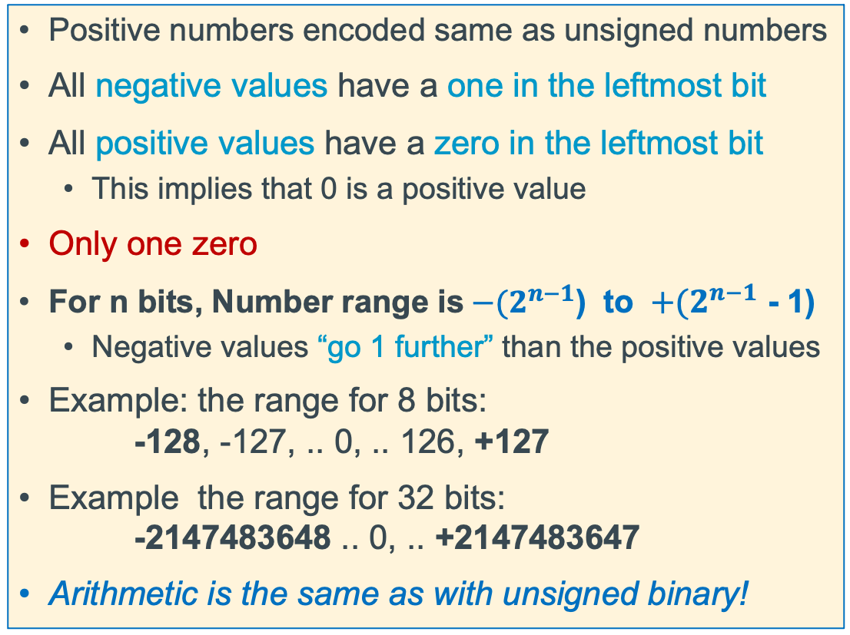
2's Complement Signed Integer Method
Positive numbers encoded same as unsigned numbers
All negative values have a one in the leftmost bit
All positive values have a zero in the leftmost bit
This implies that 0 is a positive value
Only one zero
For n bits, Number range is${ −(2}^{n−1}$) to ${ +(2}^{n−1}$ - 1)
Negative values “go 1 further” than the positive values
Example: the range for 8 bits: -128, -127, .. 0, .. 126, +127
Example the range for 32 bits: -2147483648 .. 0, .. +2147483647
Arithmetic is the same as with unsigned binary!
x

Slide 44
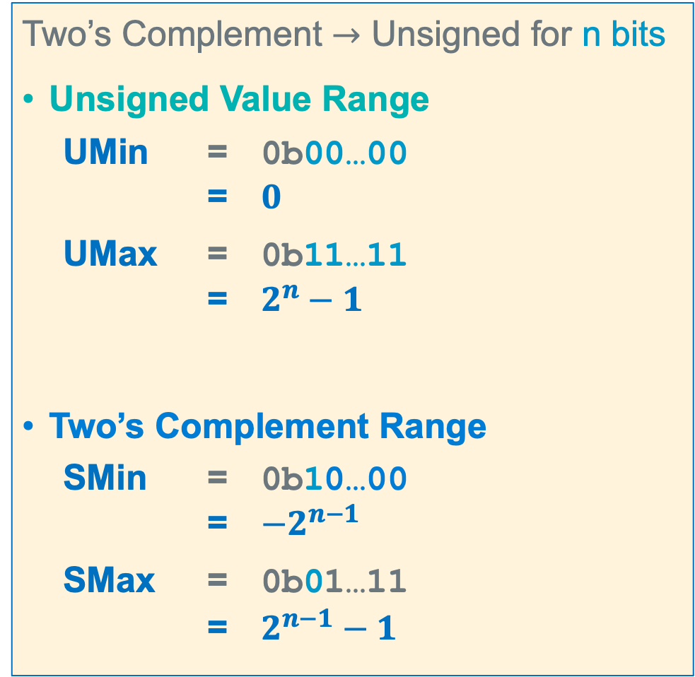
Summary: Min, Max Values: Unsigned and Two’s Complement
Two’s Complement $→$ Unsigned for n bits
Unsigned Value Range
UMin = 0b00…00 = $0$
UMax = 0b11…11 = $2^{n}−1$
Two’s Complement Range
SMin = 0b10…00 = $−2^{n−1}$
SMax = 0b01…11 = $2^{n−1}−1$
For n=4
x

Slide 45
Negation Of a Two’s Complement Number (Method 1)
7 = 0111
invert = 1000
add 1 + 1
-7 1001
-7 = 1001
invert = 0110
add 1 + 1
7 0111
-x == ~x + 1;
7 = 0111
-7 = + 1001
(discard carry) 0000
1 = 0001
invert = 1110
add 1 + 1
-1 1111
-1 = 1111
invert = 0000
add 1 + 1
1 0001
-8 = 1000
invert = 0111
add 1 + 1
-8 1000 oops!
x

Slide 46
Negation of a Two’s Complement Number (Method 2)
copy unchanged right most bit containing a 1 and all the 0's to its right
Invert all the bits to the left of the right-most 1
7 =
0 1 1
1
4 =
0
1 0 0
0 =
0 0 0 0
invert
Copy
invert
Copy
Copy
-7 =
1 0 0
1
-4 =
1
1 0 0
0 =
0 0 0 0
56 =
0 0 1 1
1 0 0 0
-8 =
1 0 0 0
invert
Copy
Copy
OOPS!
-56 =
1 1 0 0
1 0 0 0
-8 =
1 0 0 0
x

